Slide 1
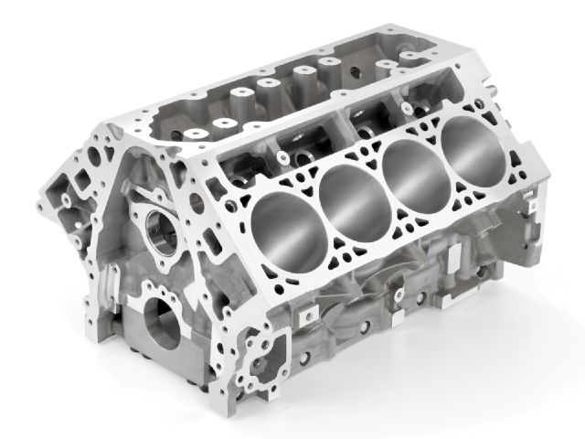
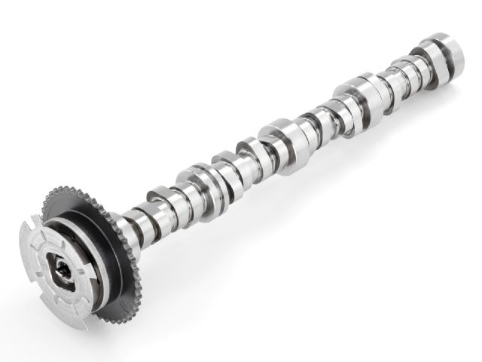
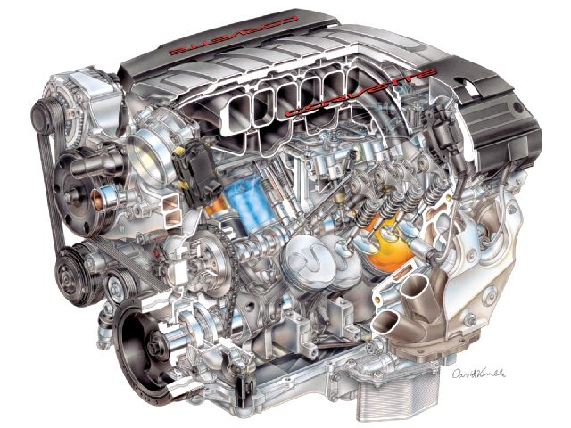
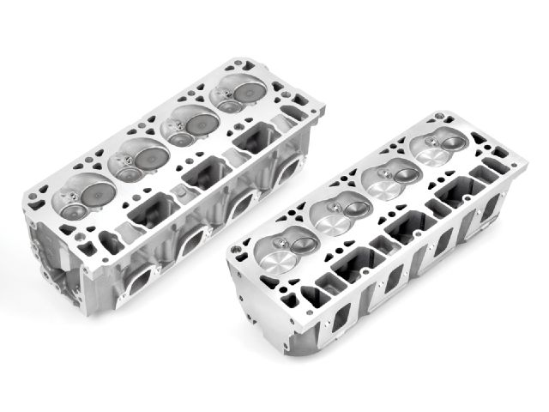
Working at st. catharines
Area of Work: GEN V – Assembly
Eng. Supervisor: Dave Keir | Eng. Mentor: George Shing / Chris Bortolotto
By: Maharshi Patel
Notes:
Introduction – GM/GF; area of work; supervisor; mentor
images
Talk about agenda

Slide 2

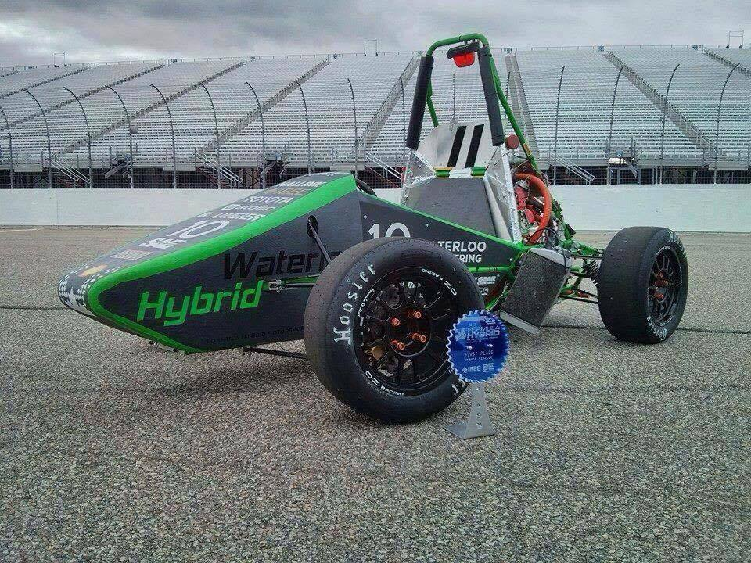

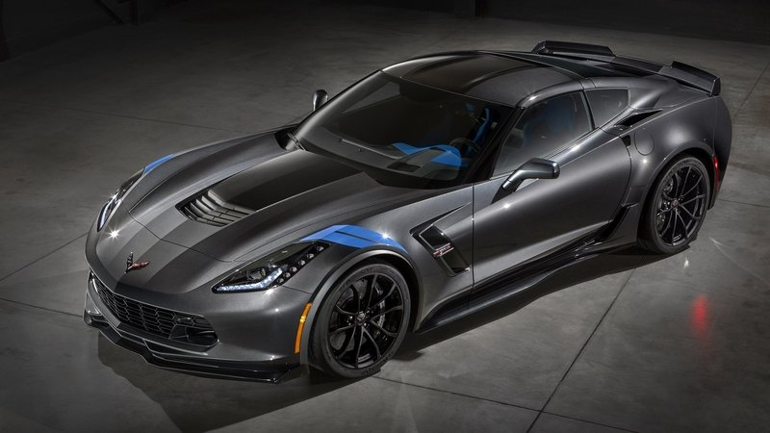
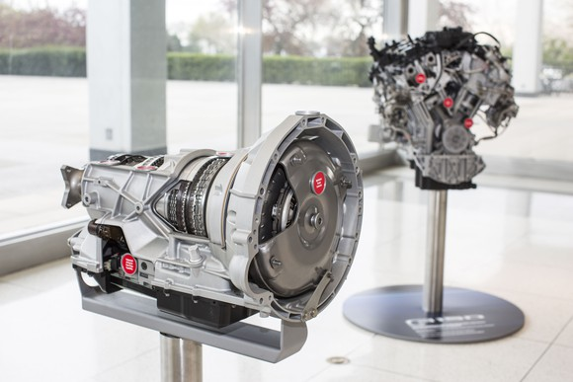
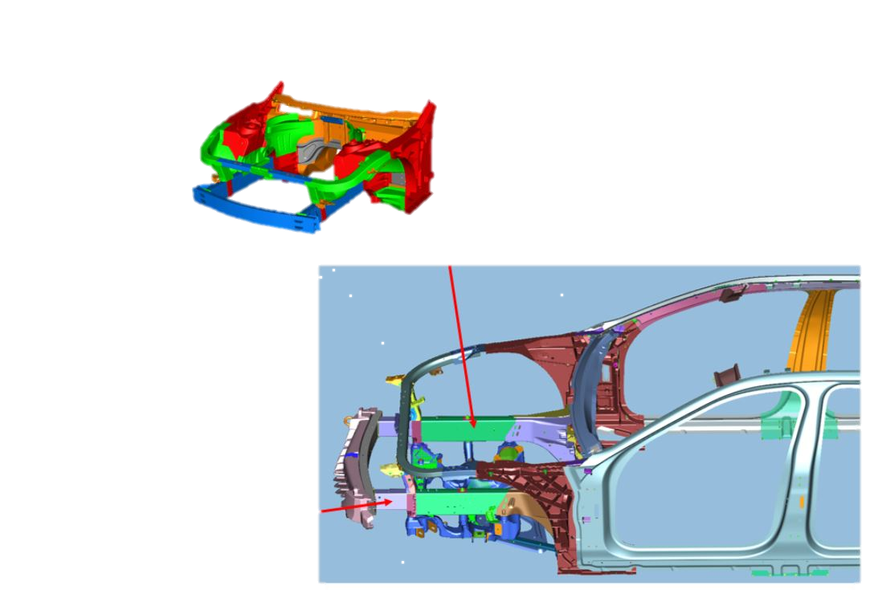
About myself
Interests
UWaterloo – Formula Hybrid
Formula 1 – AMG PETRONAS
Past Co-ops
UWaterloo-GM (Warren) [WATCar Program]
Linamar – Ford 10R60
Notes:
3rd year in mecha; uw
Past co-op
Interests f1; formula hybrid

Slide 3
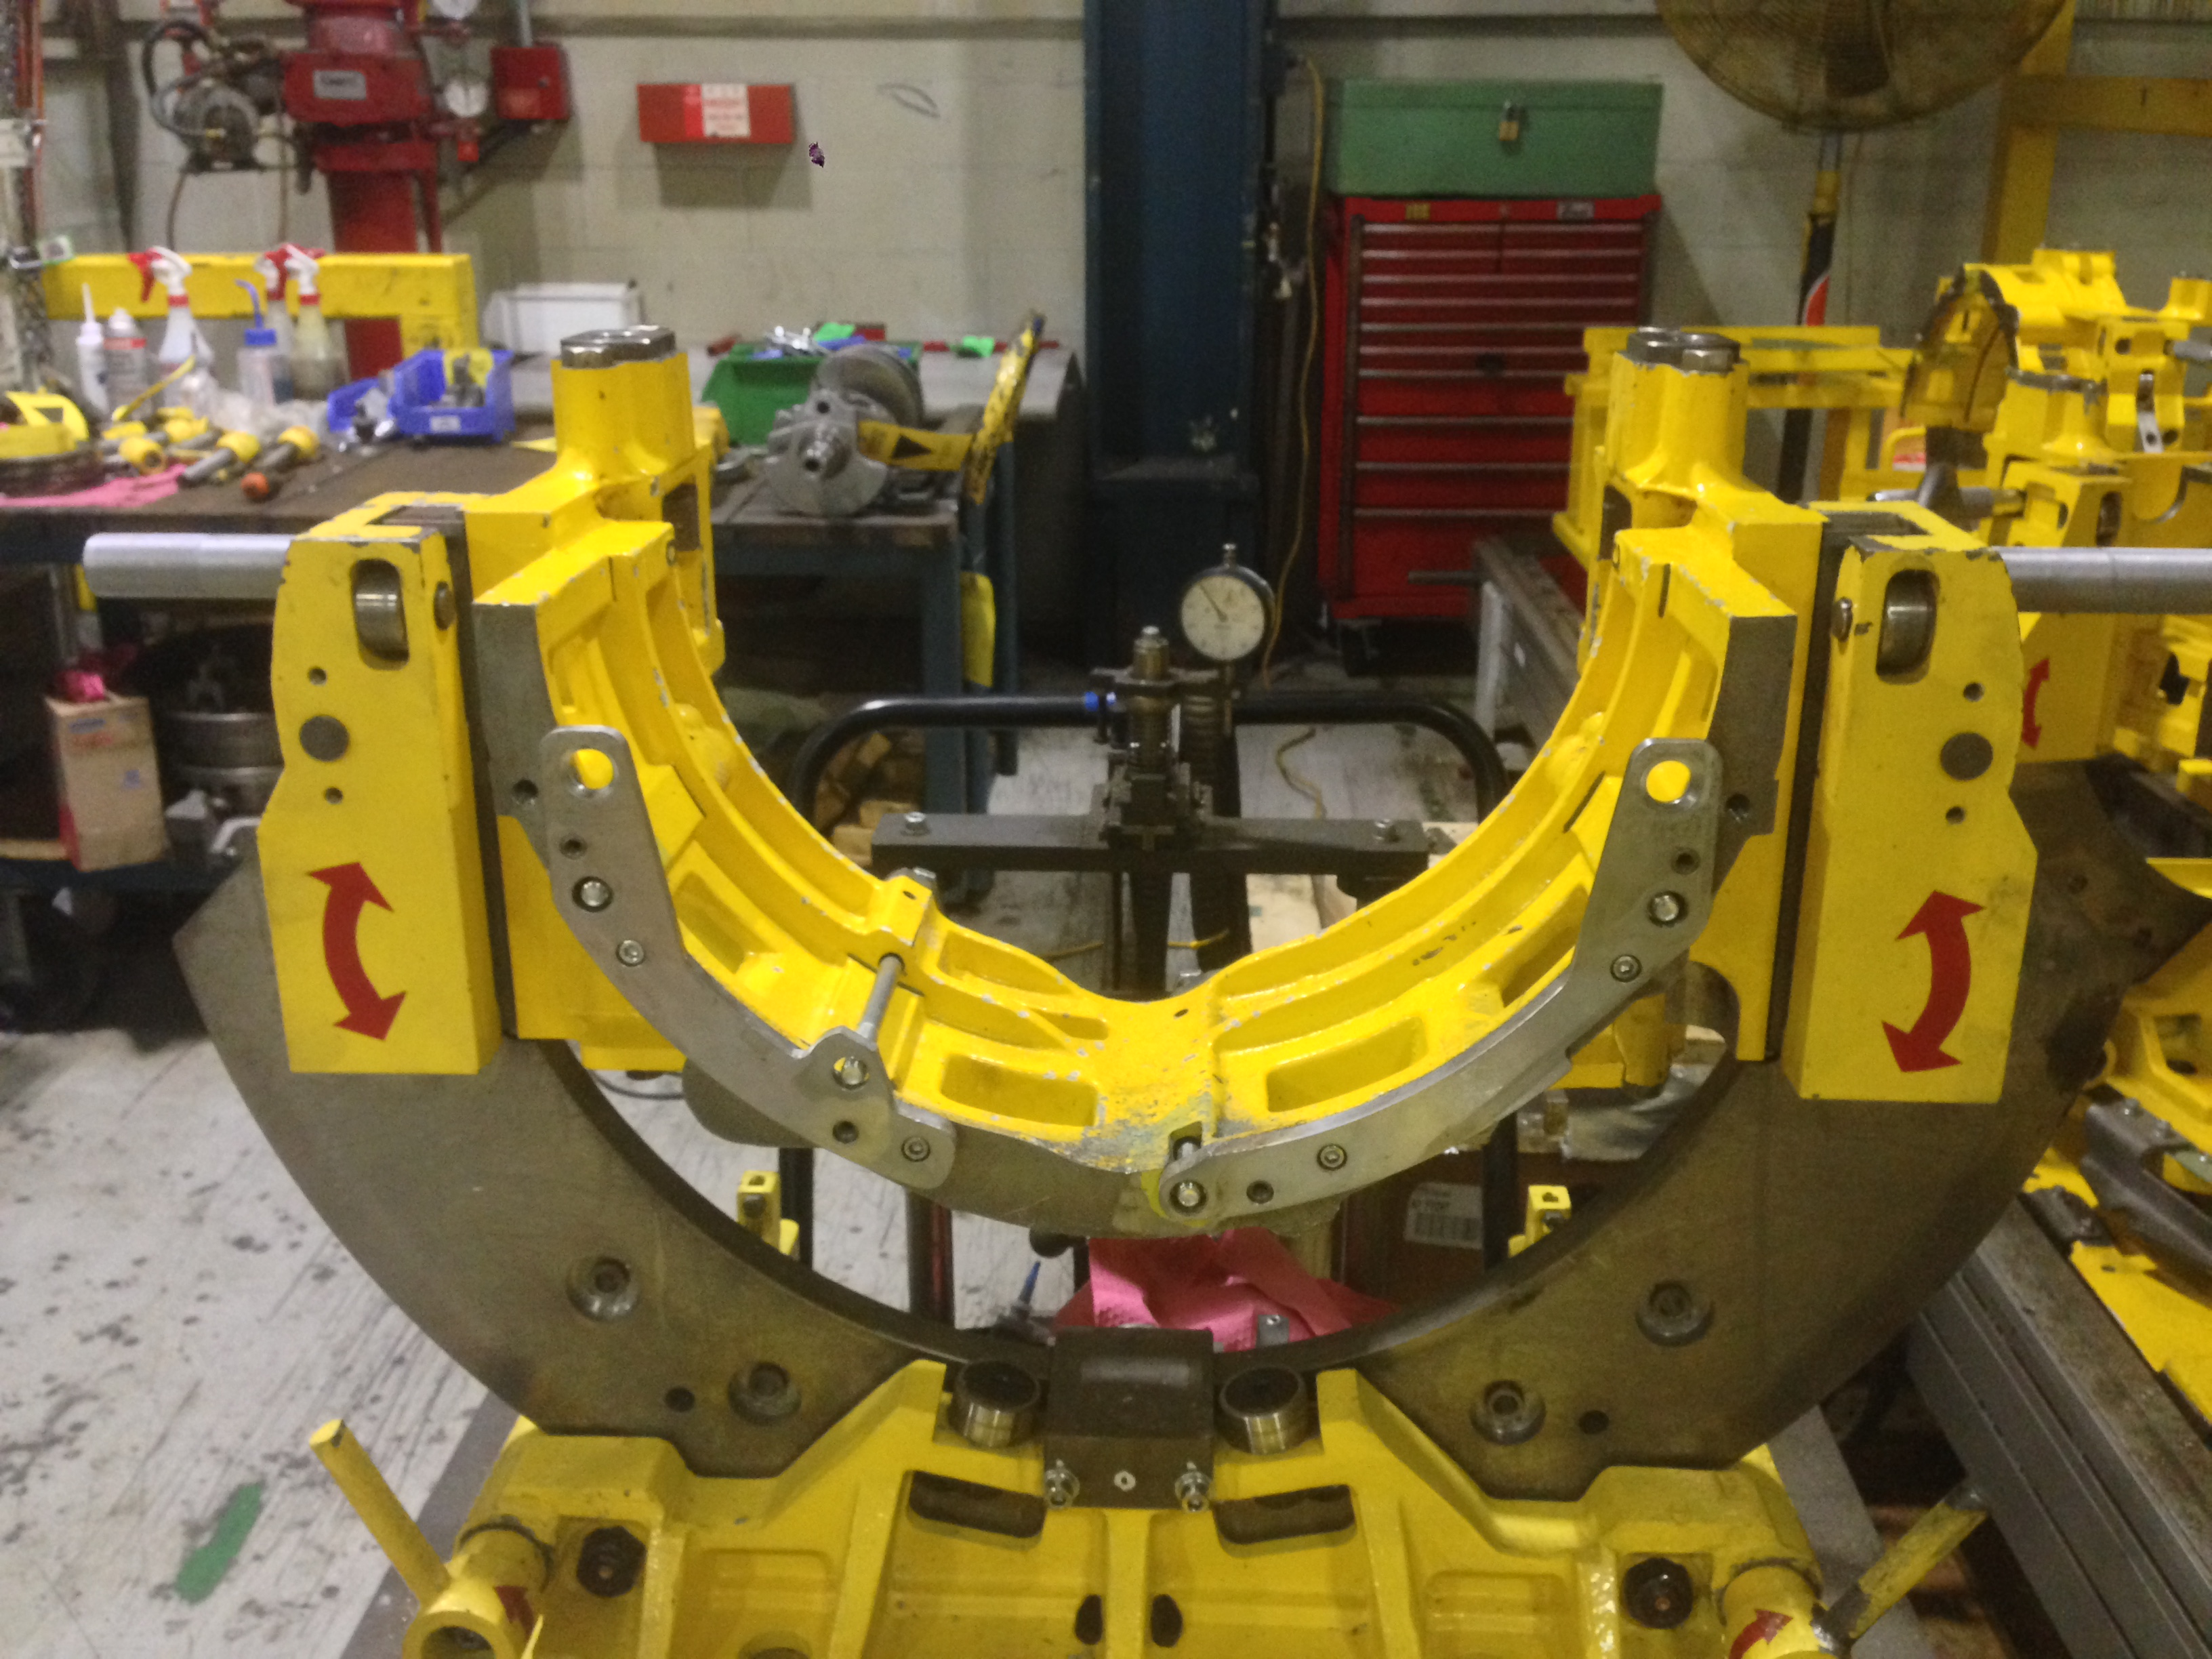
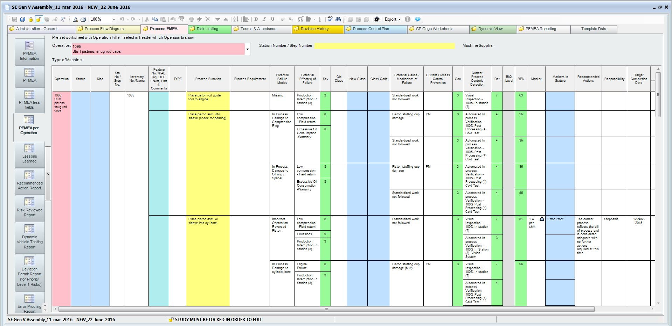
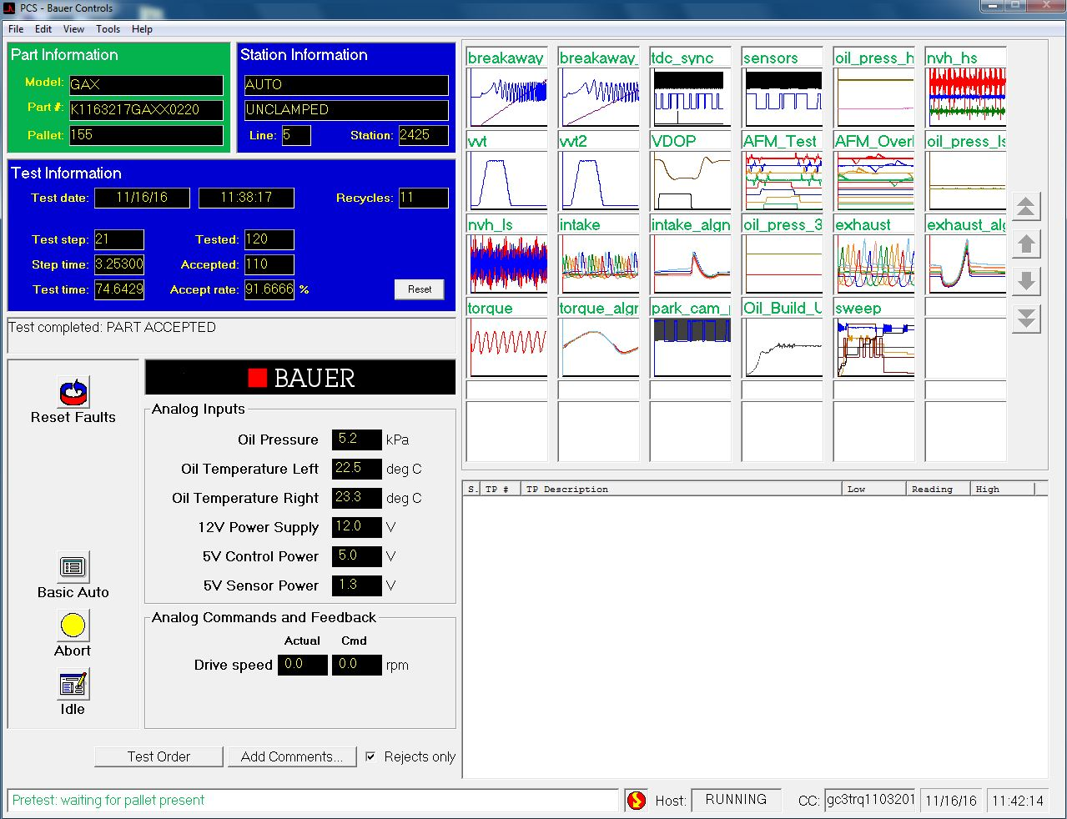

Projects Undertaken
Reducing Block Scrap – Transmission Dowel Thread Holes (OPEX)
Updated PFD and PFMEA for Gen-V Assembly
Cold Test Support
Notes:
Talk about the three projects of many
Talk about whys for each briefly

Slide 4
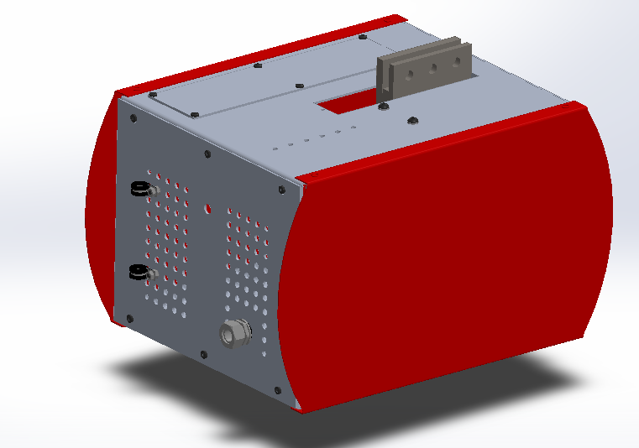
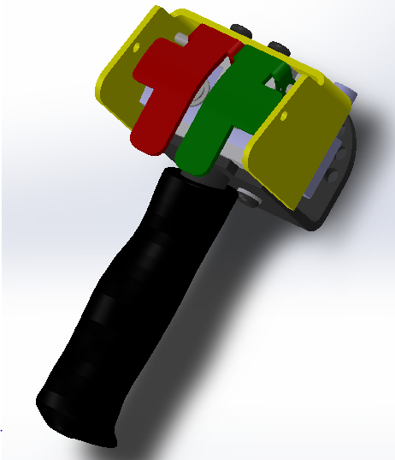
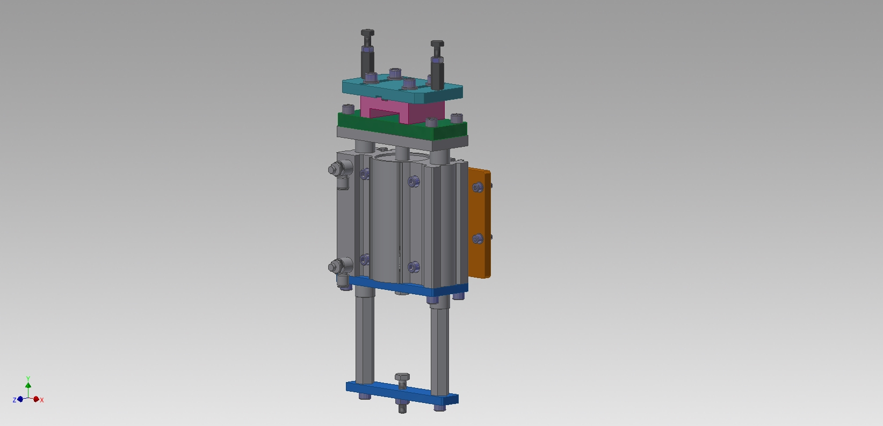
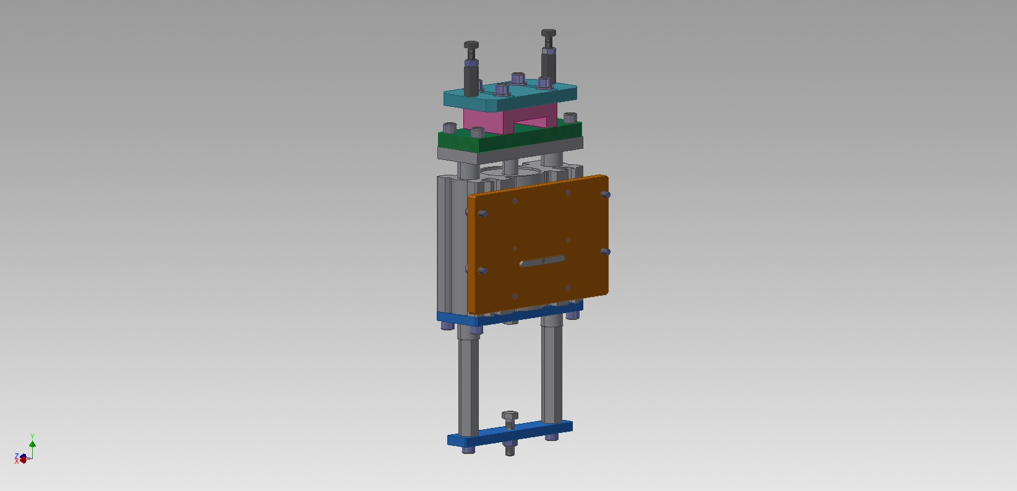
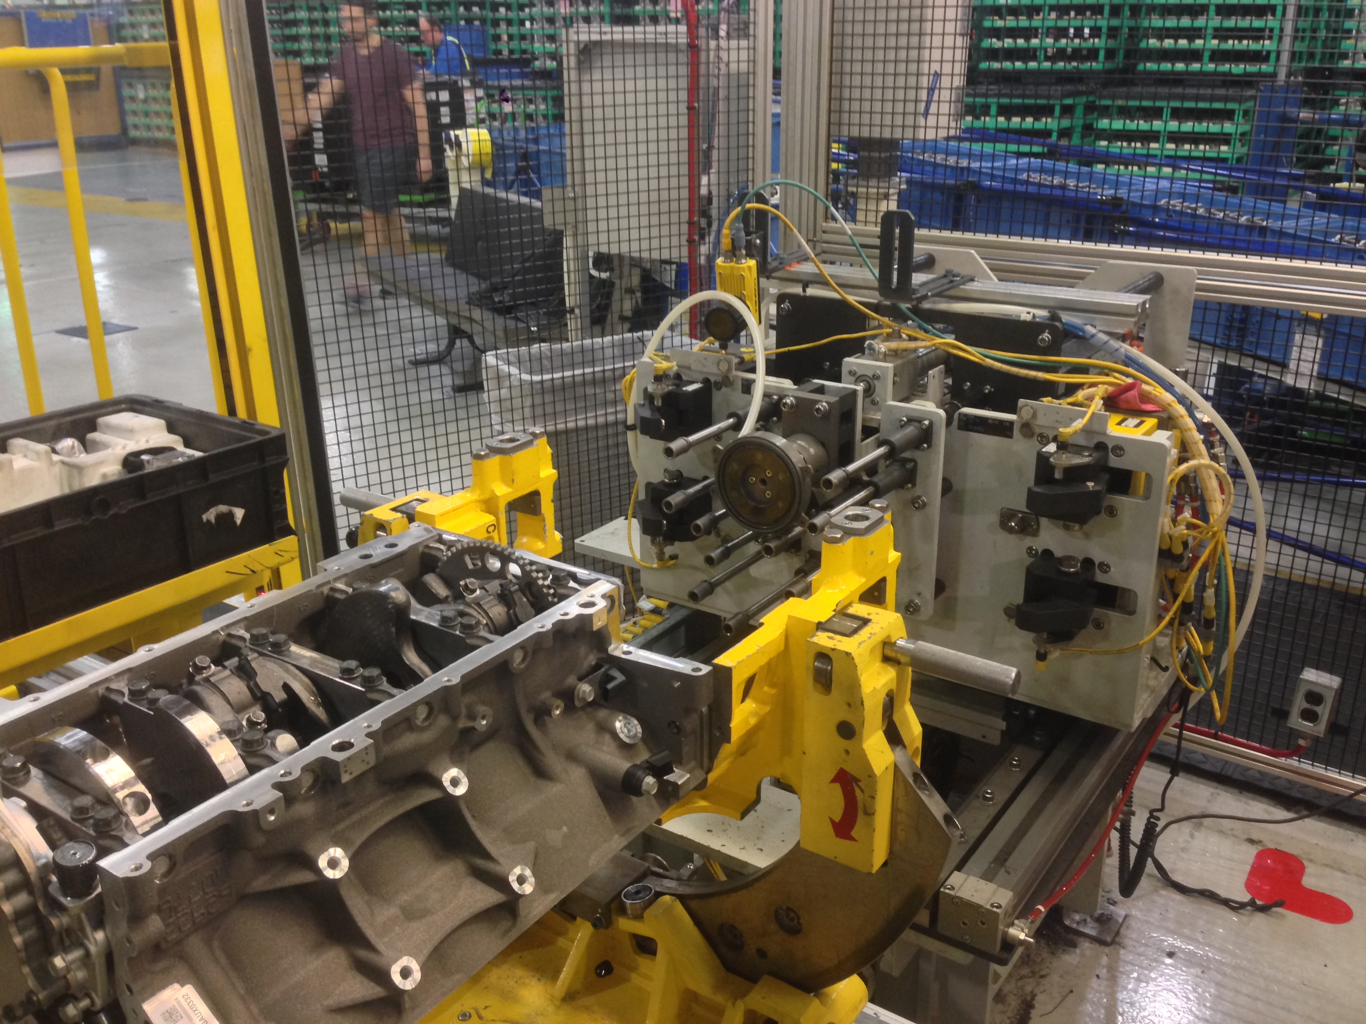
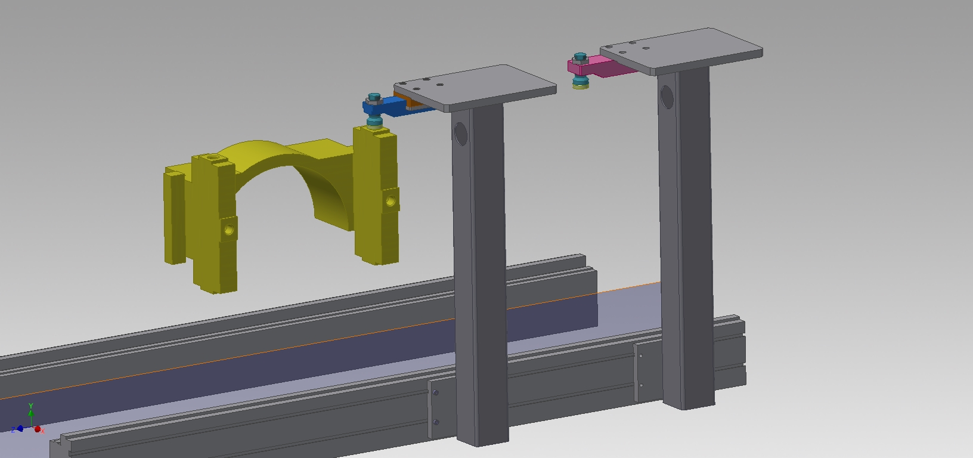
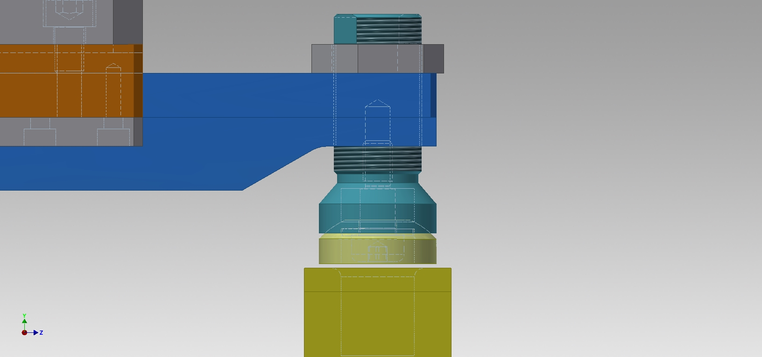
Reducing block scrap – trans. Thread bolts
Servo Motor Hoist
Pallet Lift Assist
Pallet Adapter Unit
Adapter Arm
Notes:
Of why possible solutions
4th one recent solution

Slide 5
Decision Matrix
Engineering Decision Matrix
Solutions: → |  |  | Pallet Lift Unit |  | Servo Motor Hoist |  | Pallet Adapter Unit
Criteria ↓ | Weight | Weight (%) | Rating | % | Rating | % | Rating | %
Safety | 10 | 21% | 8 | 17% | 9 | 19% | 10 | 21%
Cost to Implement | 9 | 19% | 9 | 19% | 6 | 13% | 4 | 9%
Return on Investment | 7 | 15% | 7 | 15% | 4 | 9% | 3 | 6%
Performance | 8 | 17% | 5 | 11% | 7 | 15% | 8 | 17%
Complexity | 6 | 13% | 6 | 13% | 4 | 9% | 2 | 4%
Chances of Eliminating "Knack" | 7 | 15% | 4 | 9% | 7 | 15% | 7 | 15%
Total: → | 47 | 100% | 39 | 83% | 37 | 79% | 34 | 72%
1 -> Lowest Concern 10 -> Highest Concern
Notes:
4th one not added since recent and need be safety

Slide 6
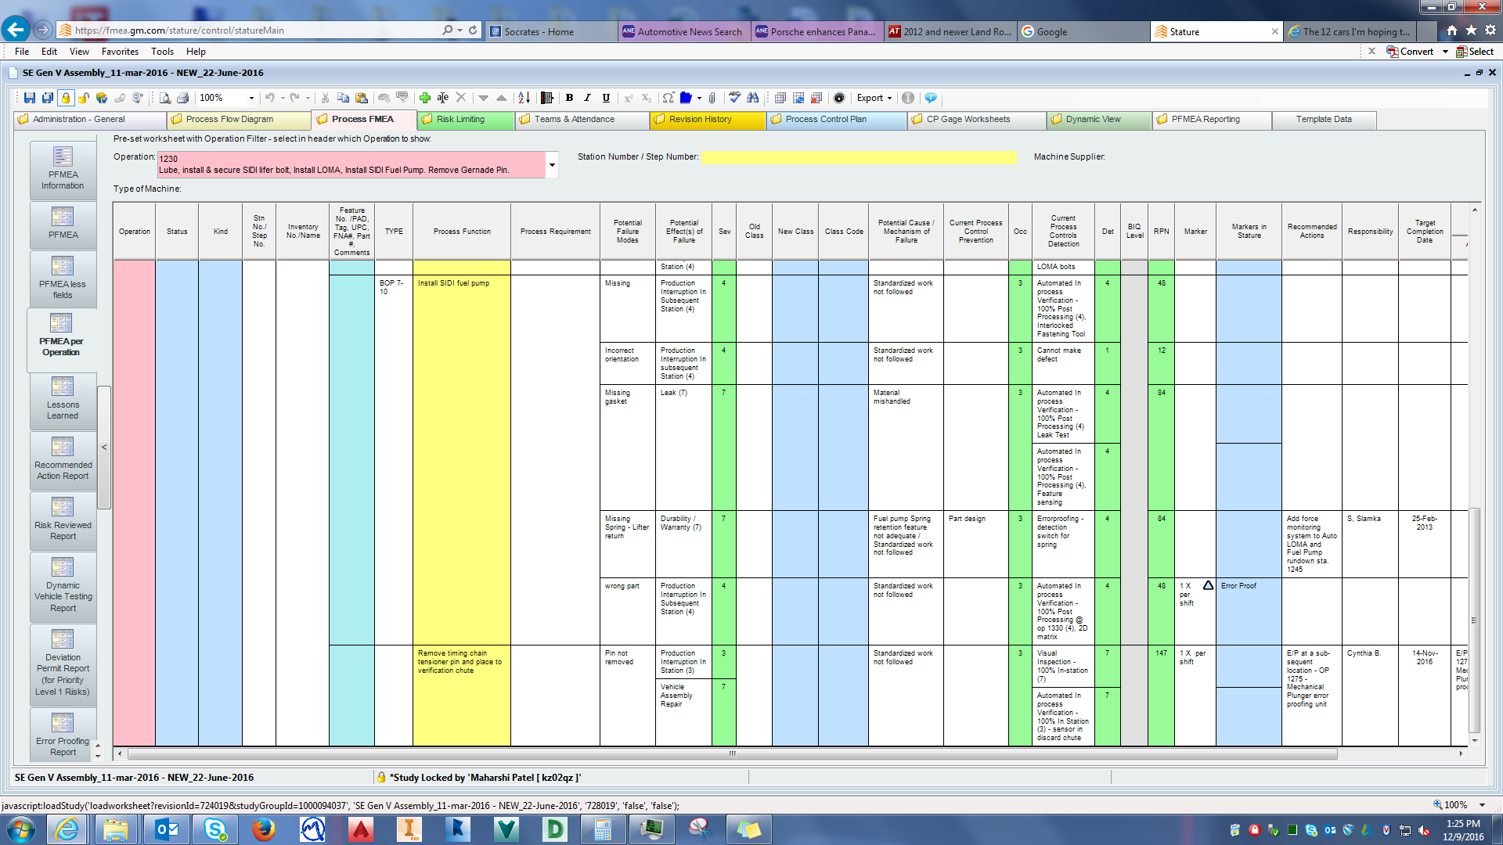
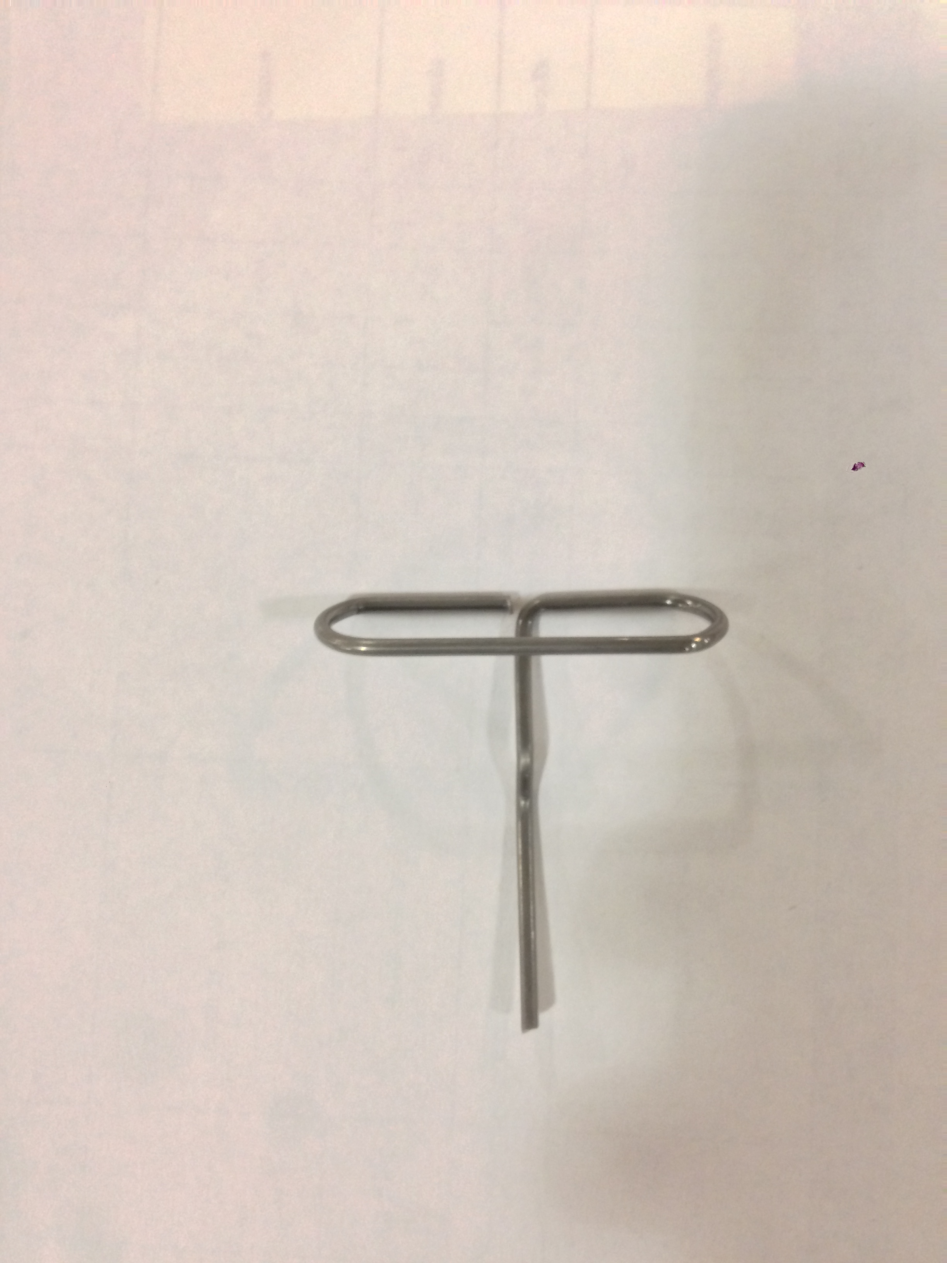
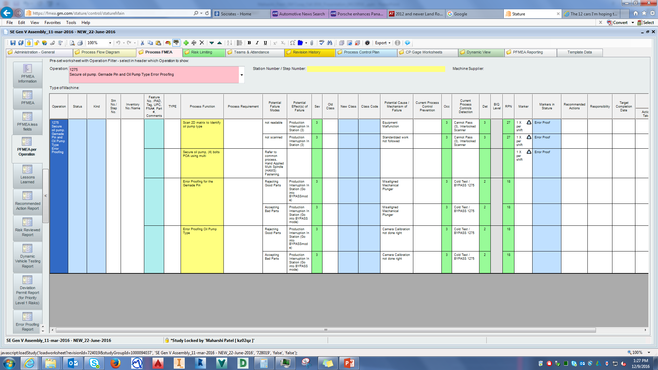
PFMEA (process failure mode and effects analysis) – Stature
OLD
Severity
Occurrence
Detection
NEW

Slide 7
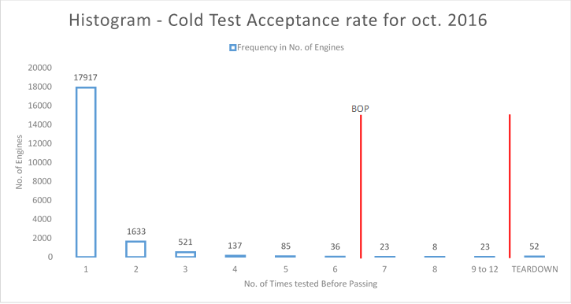
Cold test acceptance rate
No. of Test Conducted before Passing | Frequency in No. of Engines | Percentage of Total
1 | 17917 | 87.68%
2 | 1633 | 7.99%
3 | 521 | 2.55%
Total of First 3 Test |  |  | 98.22%
4 | 137 | 0.67%
5 | 85 | 0.42%
6 | 36 | 0.18%
% Engines from 4-6 Tests |  | 1.26%
% Engines from 1-6 Tests |  |  | 99.48%
7 | 23 | 0.11%
8 | 8 | 0.04%
9 to 12 | 23 | 0.11%
% Engines from 7-12 Tests |  |  | 0.26%
TEARDOWN | 52 | 0.25%
TOTAL ENGINES | 20435
Notes:
Was to see how many times for testing engines

Slide 8
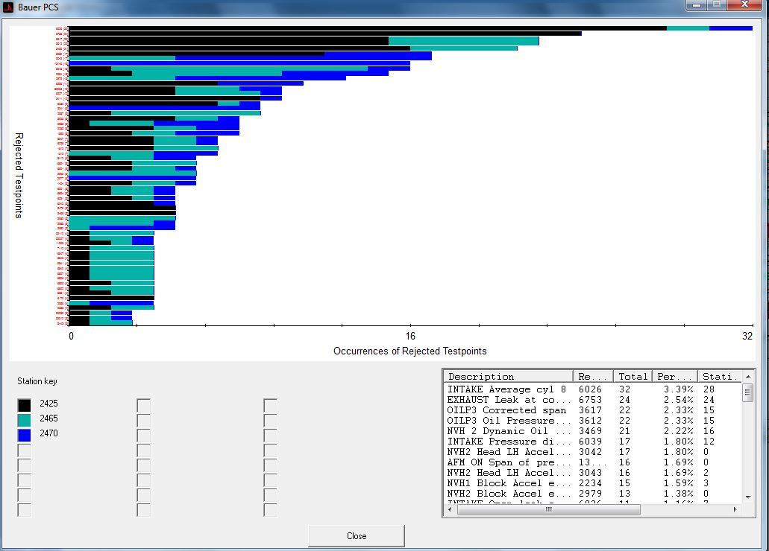
Cold test support
TOP N Rejects – Data Analysis
Notes:
TOP N Rejects

Slide 9
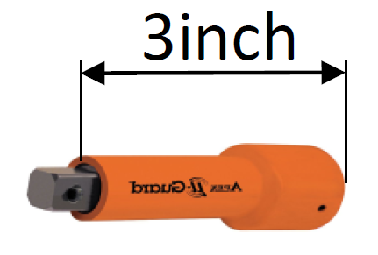
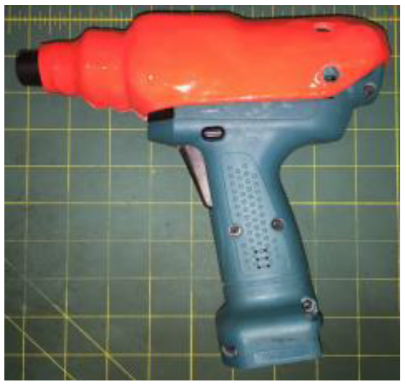
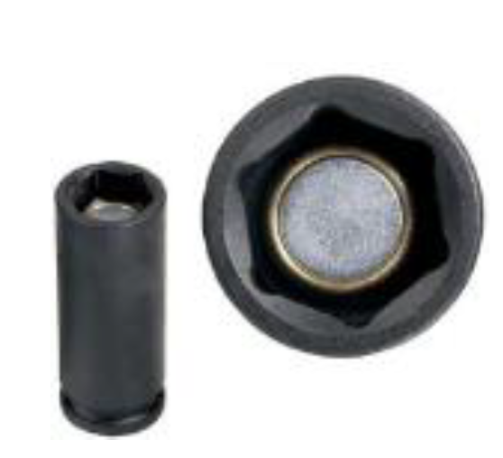
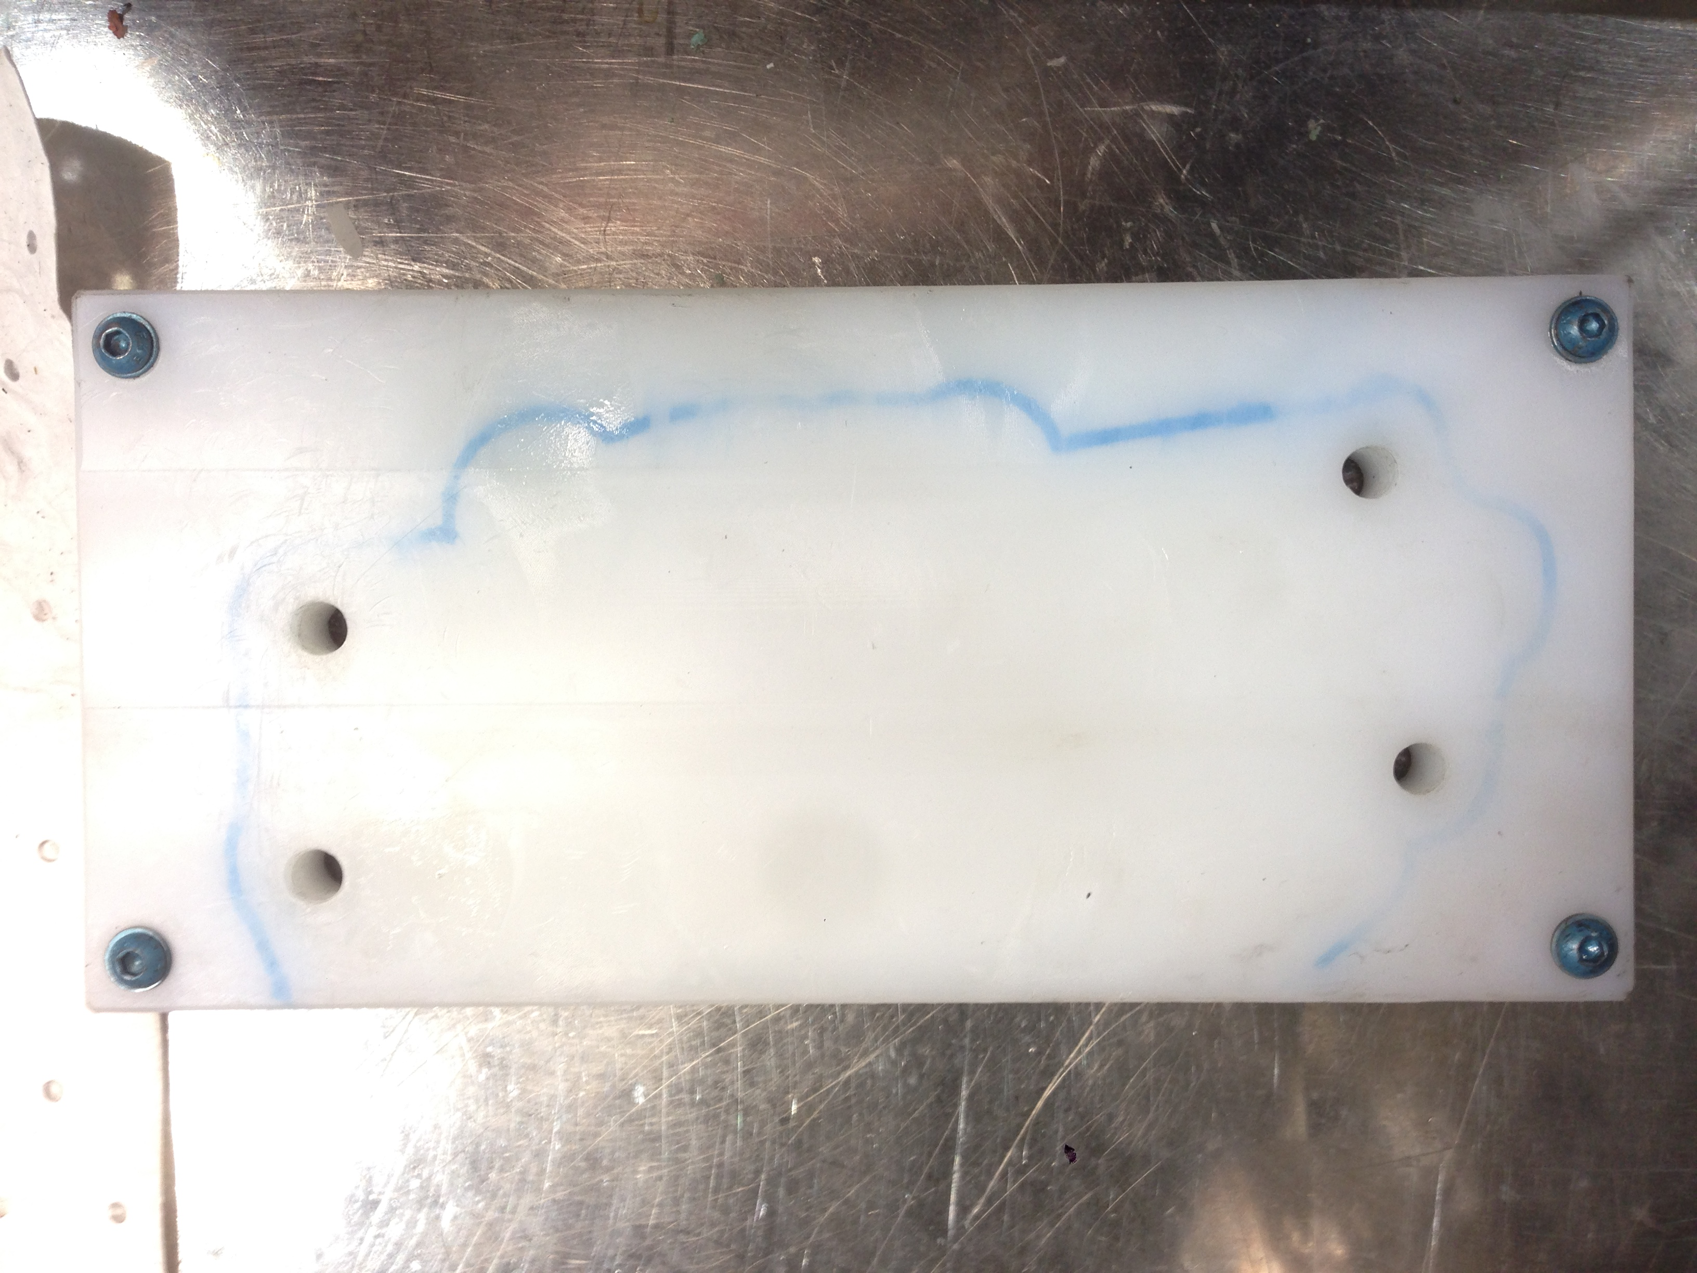
Other work undertaken
PFMEA
TOP 5 RPN
Rework List
Risk Limiting Level 1
Annual-Internal PFMEA Audit
Single Spindle Safety Initiative
Oil Pump Rework Fixture
Head Sub – OP80 Laser Key Check
6.2L Rejects
Turn Table Assist for Head Sub Load and Unload (OP10/120)
Cold Test Support
Limit Changing

Slide 10

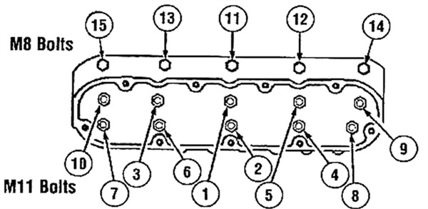
Skills obtained
Project Management
Fastening/Assembly Techniques
Engine Testing (Cold Test)
Notes:
I learned the limitation of the real world

Slide 11
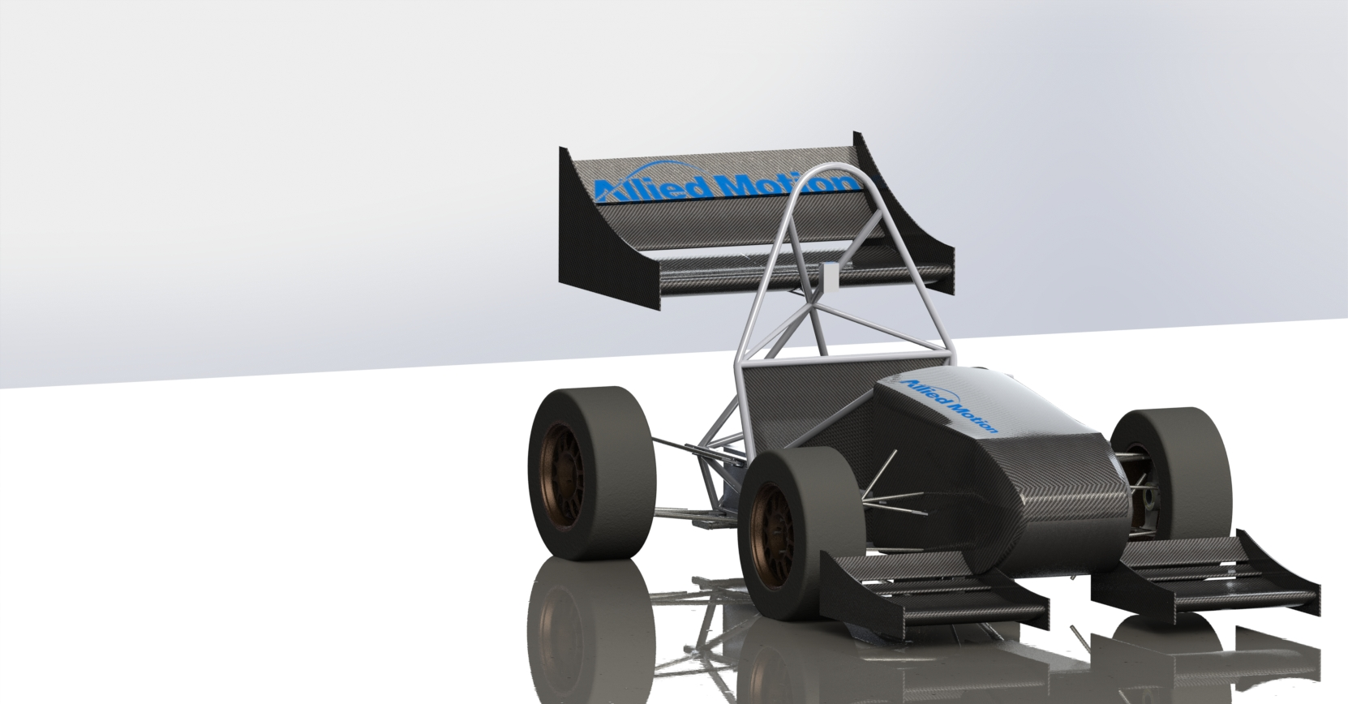
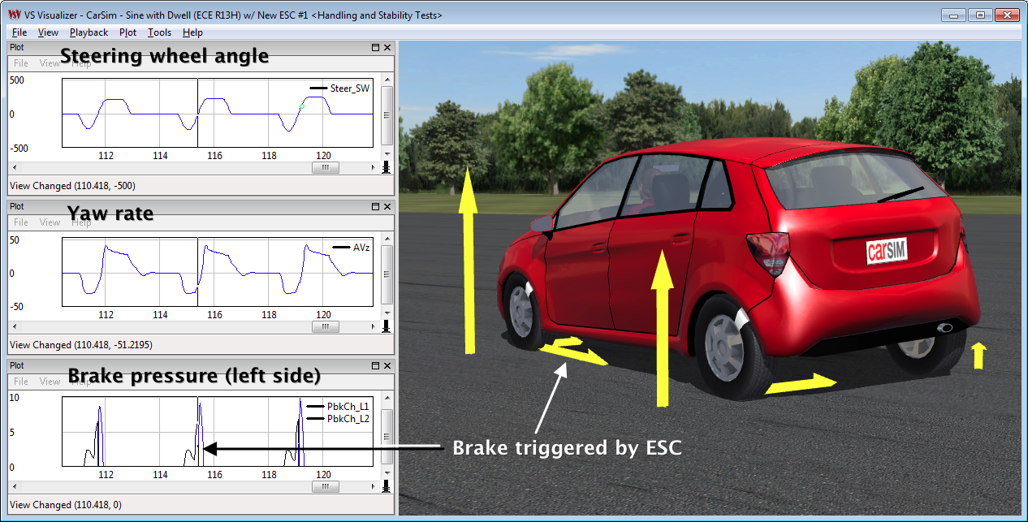
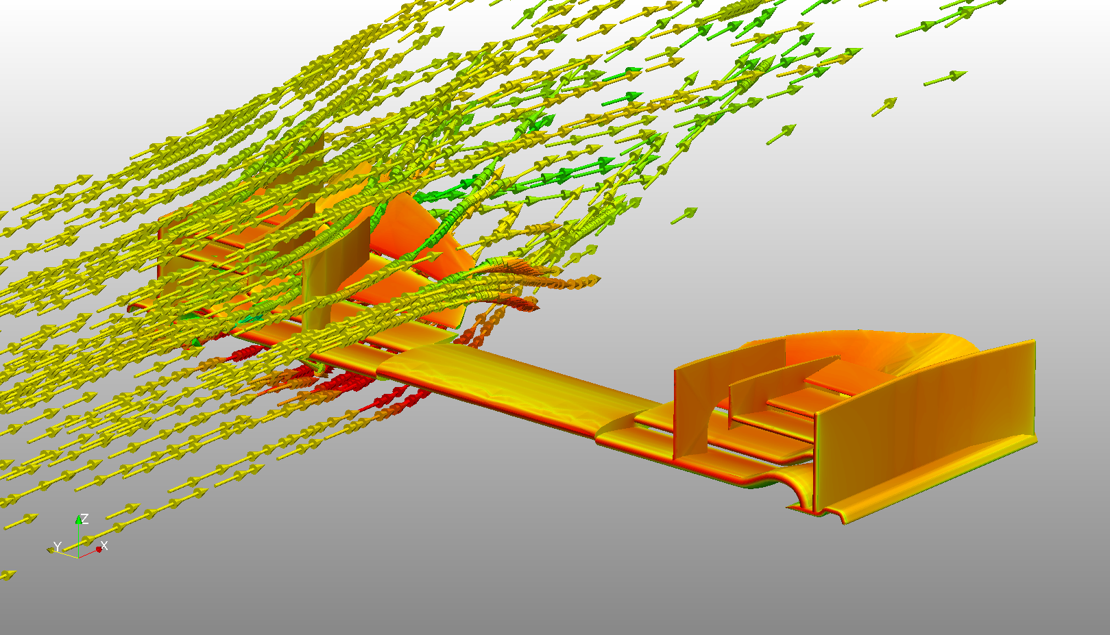
Future Plans
Complete BASc. Honours in Mechatronics Engineering
Pursue career in Automotive Design
Pursue research in fluid or solid mechanics
Make positive contributions to the world, by torqueing one bolt at a time
Notes:
MIT/IIT
Car of 2016
3D CFD – Flow
Steering angle for under/over steer gradient

Slide 12
Acknowledgements
Peter Scott
Dave Keir
George Shing
Chris Bortolotto
Cynthia Balint
Chris Brodeur
Dave Harapiak
Tino Martinez
Sean Anderson
Team Leaders – Group Leaders – Operators of GEN V Assembly
And the entire team of GM St. Catharines

Slide 13
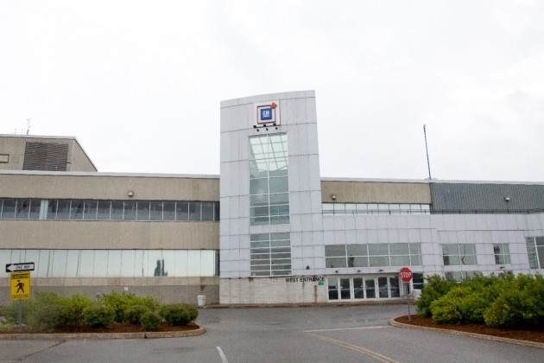
Thank You for a wonderful opportunity!

